Slide 1
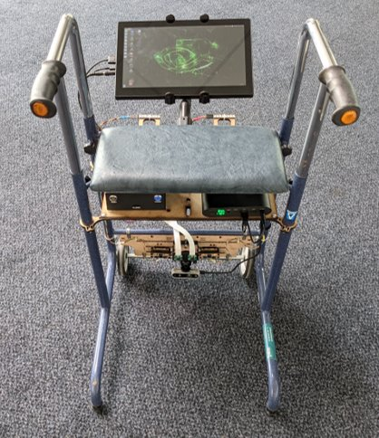
Smart Walker
Next steps

Slide 2
Concept
Affordable equipment on the walker
No sensors on user
Recognise basic walking features: regular gait, too far from the walker, …
Visual feedback on screen
Record data for future iterations

Slide 3
Prototype
Stereoscopic camera
Feedback screen
IMU sensors (in the camera)
Sonar (?)
Processor (?)

Slide 4
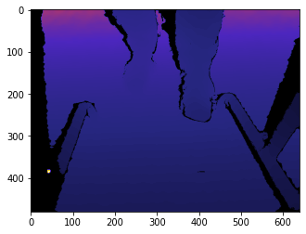
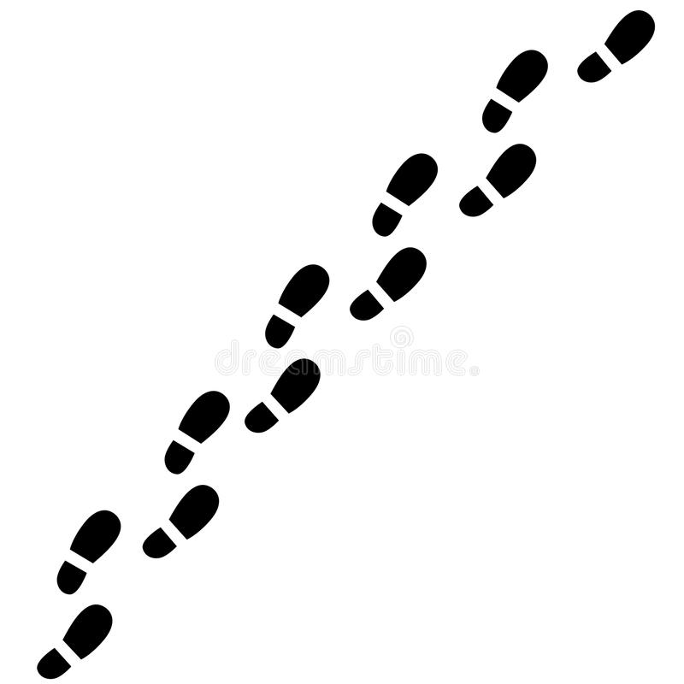
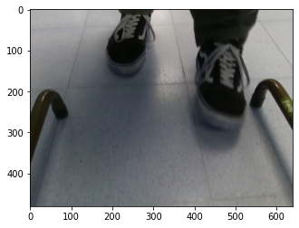
Pipeline
Positioning
Feedback

Slide 5
Positioning
Depth profile contour
Color gradient
Object recognition
Pose estimation
Template matching
Annotate walker images with sensors

Slide 6
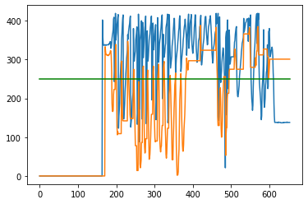
Positioning
Experiment 1 : Depth profile

Slide 7
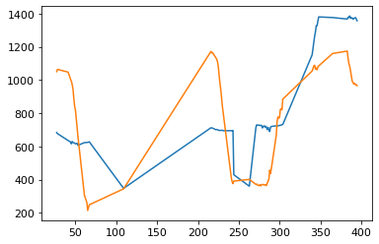
Positioning
Experiment 2 : Color gradient

Slide 8
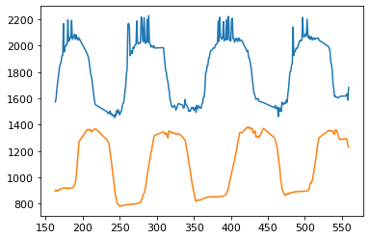
Positioning
Experiment 2 : Color gradient

Slide 9
Positioning
Experiment 3 : Object Recognition

Slide 10
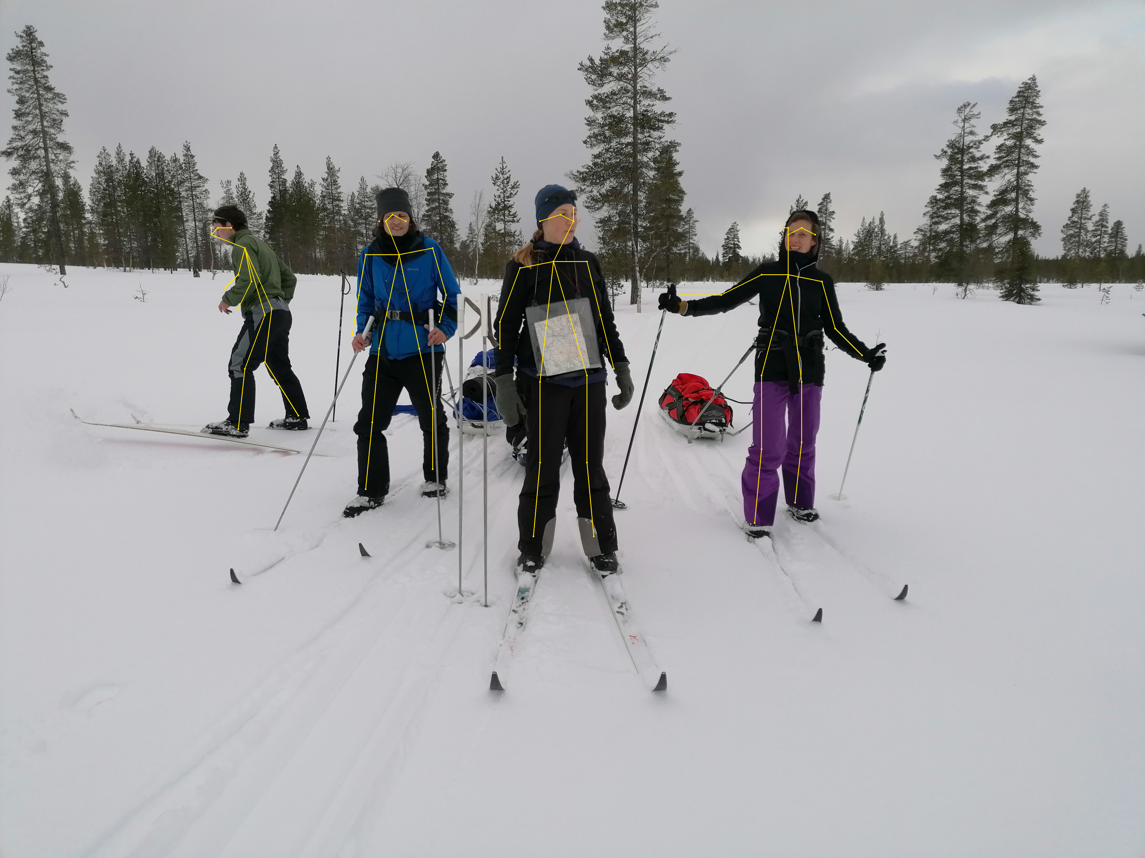
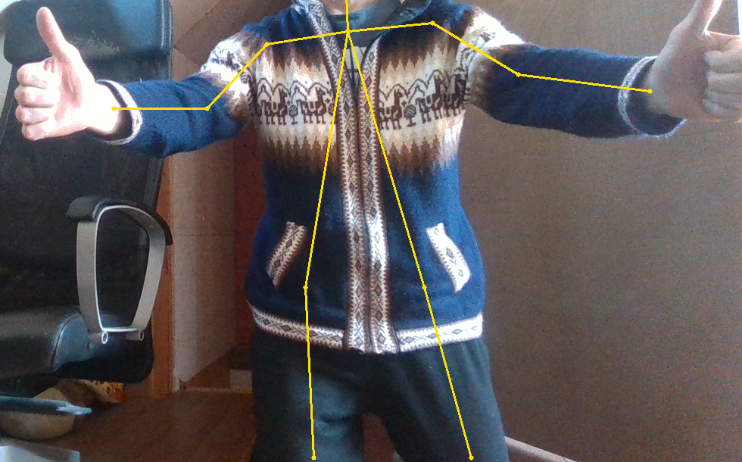
Positioning
Experiment 4 : Pose Estimation
More snow
More pose

Slide 11
Feedback (todo)
Closeness to the walker
Gait frequency
…
Use AI if time/data permits:
learn critical distance
learn other wrong behaviour with RF
Close collaboration with physiotherapists

Slide 12
Next steps
Optimize feet recognition
Combine depth/pose detectors
Train yolo network on labeled feet data
Add flow recognition
Feedback from positions
Clean data
Handpick/learn relevant scenario’s

